Slide 1


Statistical Modelling with Data
May 23 – June 02, 2023
Instructor: Qing (Leah) Li, Ph.D. Candidate at Cumming School of Medicine
qing.li2@uclagary.ca
Thank you Dr. Thuntida Ngamkham for contributing the contents
Thank you Dr. Qingrun Zhang and Dr. Quan Long for contributing some slides

Slide 2
Statistical Modelling with Data
Topic 1: Statistical Modelling
Lecture 1: First-order models with quantitative independent variables
Topic 2: Statistical Modelling with interactions (Assignment 1)
Lecture 2: Interaction effects, quantitative and qualitative variables
Lecture 3: Interaction effects and second-order models
Topic 3: Statistical Model selection (Assignment 2)
Lecture 4: Model selection: Stepwise regression, Forward selection and Backward Elimination
Lecture 5: Model selection: Evaluate the reliability of the model chosen
Topic 4: Statistical model diagnostics
Lecture 6: Multiple regression diagnostics: verify linearity, independence, equal variance assumptions and normality assumptions.
Lecture 7: Multiple regression diagnostics: identify multicollinearity and outliers and data transformation.
Topic 5: Transfer learning
Lecture 8: Deep learning basics
Lecture 9: Transfer-learning (Bonus): standing on the shoulders of giants.

Slide 3
Statistical Modelling with Data
Topic 1: Statistical Modelling
Lecture 1: First-order models with quantitative independent variables
Topic 2: Statistical Modelling with interactions (Assignment 1)
Lecture 2: Interaction effects, quantitative and qualitative variables
Lecture 3: Interaction effects and second-order models
Topic 3: Statistical Model selection (Assignment 2)
Lecture 4: Model selection: Stepwise regression, Forward selection and Backward Elimination
Lecture 5: Model selection: Evaluate the reliability of the model chosen
Topic 4: Statistical model diagnostics
Lecture 6: Multiple regression diagnostics: verify linearity, independence, equal variance assumptions, and normality assumptions.
Lecture 7: Multiple regression diagnostics: verify, identify multicollinearity and outliers and data transformation.
Topic 5: Transfer learning
Lecture 8: Deep learning basics
Lecture 9: Deep learning advances: Transfer-learning (Bonus).
Notes:
The first lecture does not frighten you. I hope you can still bare with my English with accents for the rest of courses.
Many I ask some of your feedbacks for yesterday’s courses? You know these courses won’t be graded and all we ask is to attend six lectures to get the certificate. However, there must be something more than certificate you want to get from this course. I hope that I can really help you understand some basics of statistical modelling. I am not sure what’s your exceptions from this course.

Slide 4
Statistical Modelling with Data
Learning Outcomes: At the end of the course, participants will be able to
Model the multiple linear relationships between a response variable (Y) and all explanatory variables (both categorical and numerical variables) with interaction terms. Interpret model parameter estimates, construct confidence intervals for regression coefficients, evaluate model fits, and visualize correlations between a response variable (Y) and all explanatory variables (X) by graphs (scatter plot, residual plot) to assess model validity.
Predict the response variable at a certain level of the explanatory variables once the fit model exists.
Implement R-software and analyze statistical results for biomedical and other data.
Evaluations
Assignments will be posted on Slack (our communication tool with students).
Students must attend 70% (6/9) of the sessions in order to receive the certificate and are encouraged to work on the assignments progressively throughout the course as the relevant material is covered.

Slide 5

Statistical Modelling with Data
Supportive materials
Lectures slides (2023)
R code scripts (2023)
PDF (dated 2022)
Two Assignments (dated 2022)
Slack channels
Recoding videos
Exercises
Course-documents

Slide 6
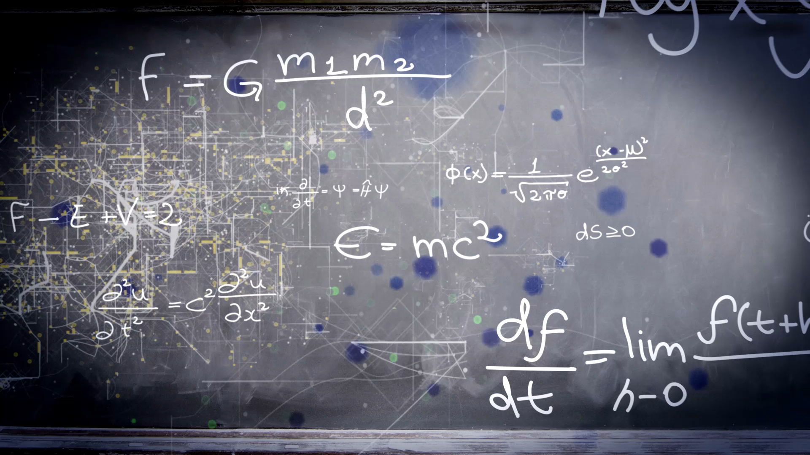
Lecture 6: Multiple regression diagnostics: verify linearity, independence, and equal variance,

Slide 7
Plots
R: plot()
Pros:
Easy to write and learn by heart
Cons:
Does not incorporate advanced functions such as fitting curves to points
Multiple figures in one panel
par(mfrow=c(nrow, ncol))
ggplot2 package: ggplot()
Pros:
Multiple choices, high-level functions
Cons:
It takes a while to understand and learn the functions by heart
Multiple figures in one panel
grid.arrange(p1,p2, nrow = 3,top = “Title").

Slide 8
Workflow of regression analysis
State a hypothesis
Data exploration
Build a statistical model
Model Diagnostics:
Residual VS fitted plot, Normal QQ plot of residuals, added variables plots, influence plot (residual vs. leverage)
Fix the biggest problem and go back to 3
Compare alternative models with reduced model
Interpret the regression coefficients are the effect large and what they mean in your research context.

Slide 9
Workflow of regression analysis ( modified by Leah)
State a hypothesis
Data exploration
Build statistical models (different approaches)
Diagnose if the optimal model from different approaches violet assumptions or not. If not, these model are validated.
If not, fix the problem and conduct model diagnostic until identify a model satisfy all assumptions.
Interpret the regression coefficients are the effect large and what they mean in your research context.

Slide 10
What are model diagnostics?
Most statistical tests rely upon certain assumptions about the variables used in the analysis. When these assumptions are not met the results may not be trustworthy. The assumptions and conditions for the multiple regression model sound nearly the same as for simple linear regression, but with more variables in the model.
Even if you have a solid theoretical basis for your assumptions, they may still turn out to be incorrect.
Model diagnostics are visual and numeric guides to:
Help decide whether the assumptions taken hold up in all samples;
Provide an indication of why an assumption is violated.
Model diagnostics are not:
An indication that the assumption are correct
An indication that the model is right or wrong. We hope to find our optimal model does not violate any of these assumptions.
Assumptions must be based on theory. No test or visual diagnostic plot can tell you which assumption to choose, only whether they hold up reasonably well in your studies samples or not.

Slide 11
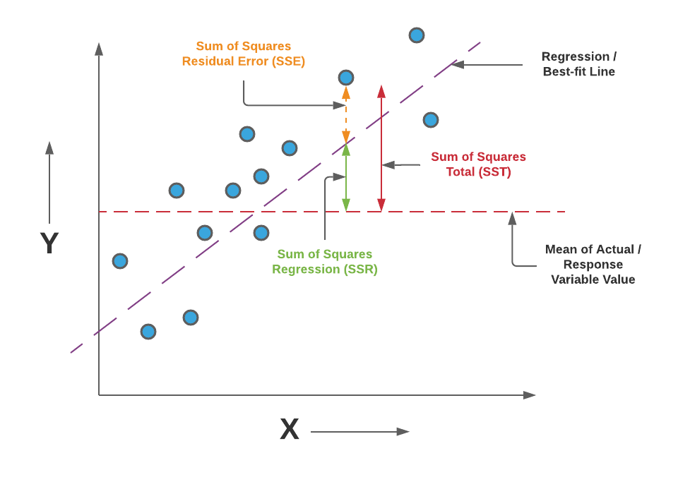
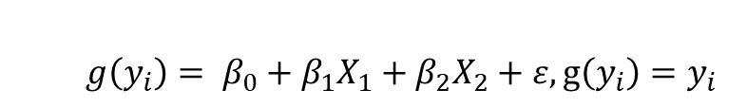
Assumptions
response, coefficients of correlation, predictors
$$g\left(y_{i}\right)= β_{0}+β_{1}X_{1}+β_{2}X_{2}+ε, g\left(y_{i}\right)=y_{i}$$
Linearity Assumption
Relationships between all predictors and the response are linear
Independence Assumption
Independence of observations
Equal Variance Assumption
Error term (Residuals) has equal variance given any values of independent variables
Normality Assumption
Error term (Residuals) is normally distributed
Outlier
Error terms (Residuals) has expected value of zero given the values of independent variables
Multicollinearity
No perfect collinearity and non-zero variance of independent variables

Slide 12
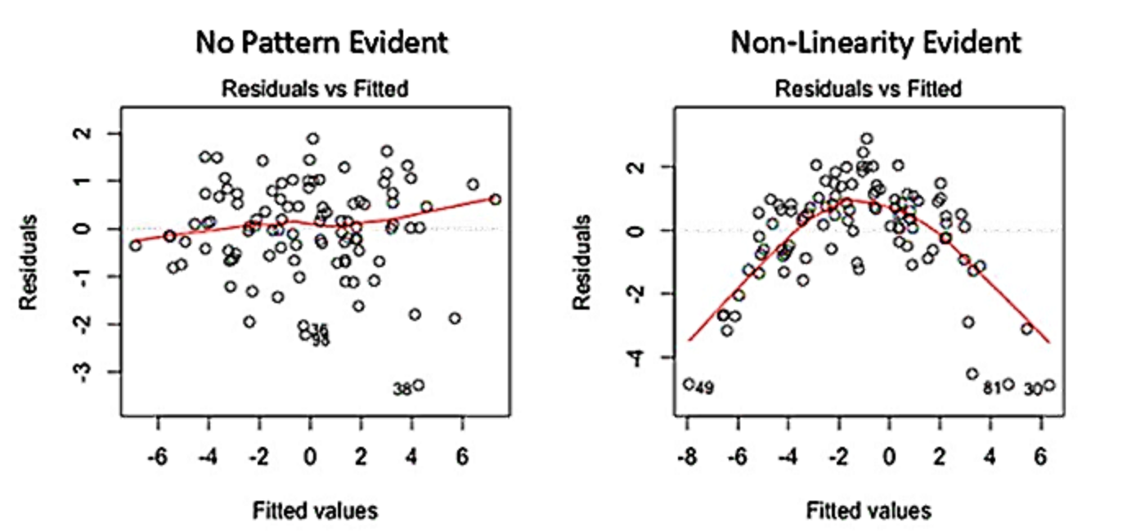
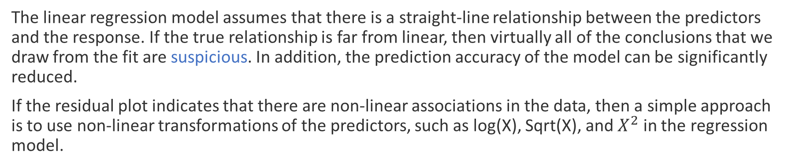
1. Linearity Assumption
The linear regression model assumes that there is a straight-line relationship between the predictors and the response. If the true relationship is far from linear, then virtually all of the conclusions that we draw from the fit are suspicious. In addition, the prediction accuracy of the model can be significantly reduced.
If the residual plot indicates that there are non-linear associations in the data, then a simple approach is to use non-linear transformations of the predictors, such as log(X), Sqrt(X), and $X^{2}$ in the regression model.

Slide 13
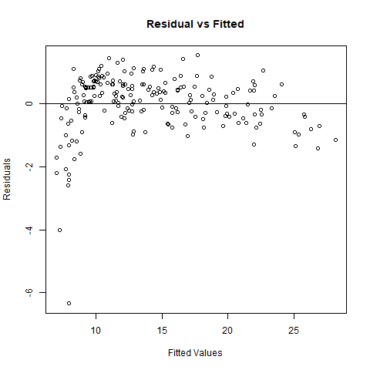
Advertising data
model<-lm(sale~tv+radio+tv:radio, data=Advertising)
There appears to be a little pattern in the residuals,
suggesting that the quadratic term or logarithmic might improve the fit to the data.

Slide 14
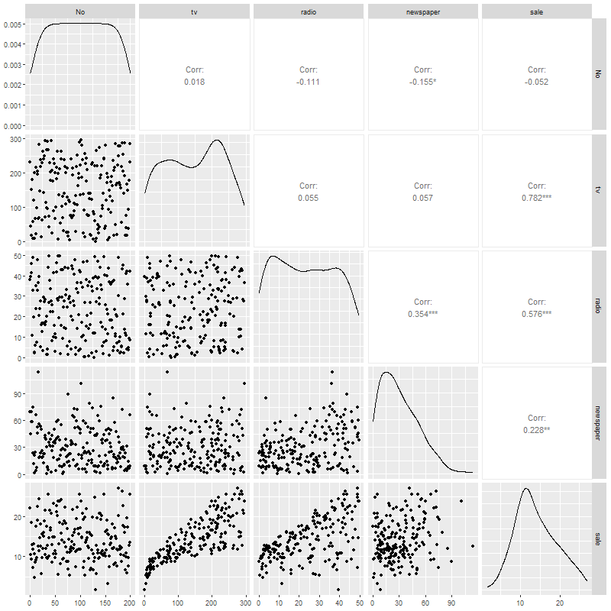
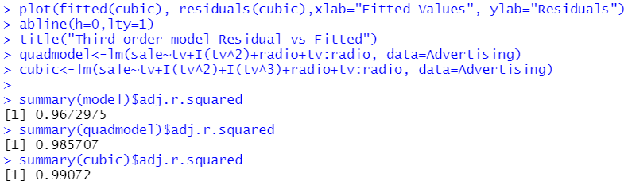
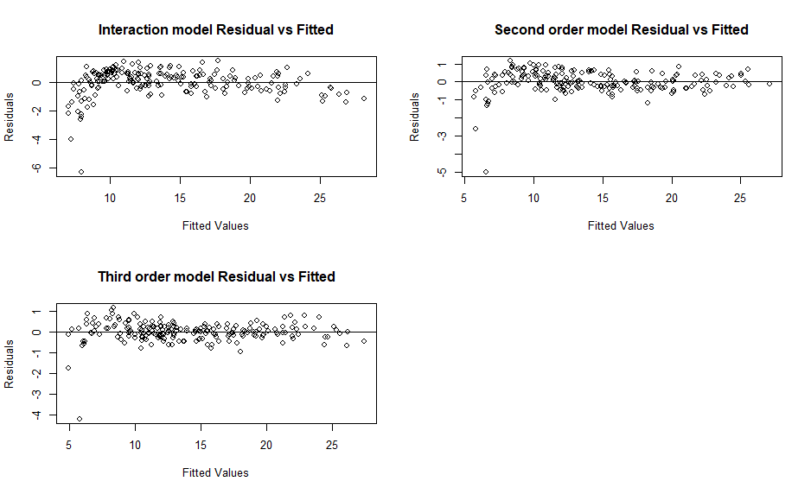
Advertising data: Pairwise correlation
Conclusion: residuals from third order model do not have an obvious pattern with fitted values.

Slide 15


In class Practice Problem 16
From the clerical staff work hours, use residual plots to conduct a residual analysis of the data.
Begin with the model: Y ~ X2 + X4 + X5
Check whether this model meets the linearity assumption
If it doesn’t (it doesn’t), use ggpairs() to identify potential terms that might be transformed in a higher order model.
Fit that higher order model and evaluate.
Lecture_6.R
15

Slide 16
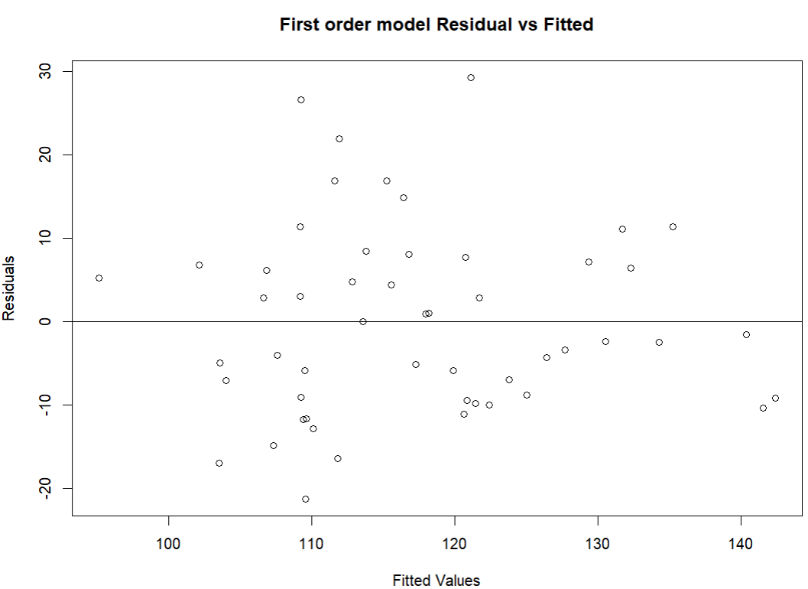
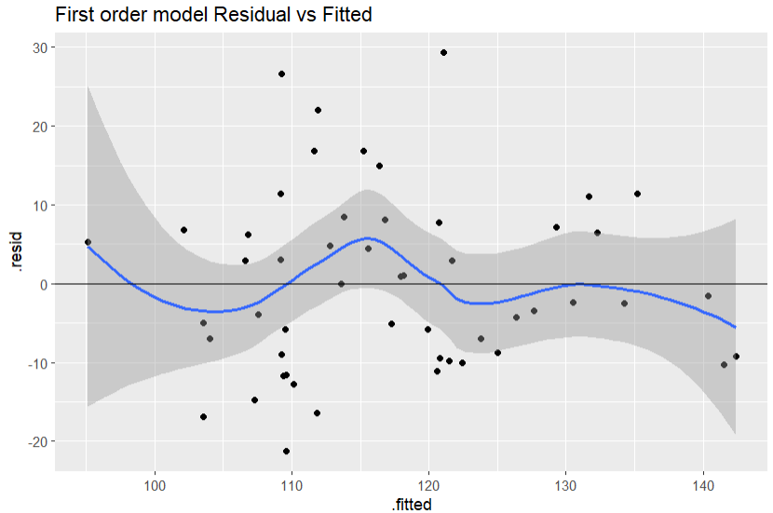
In class Practice Problem 16 Answers
Pattern is not quite obvious with plot, but observable. Maybe better with ggplot() as it can fit a line to data
Based on these two figures, we observed patterns between residuals of the model and response.
>>This model does not satisfy the linearity assumption.
Lecture_6.R
16

Slide 17
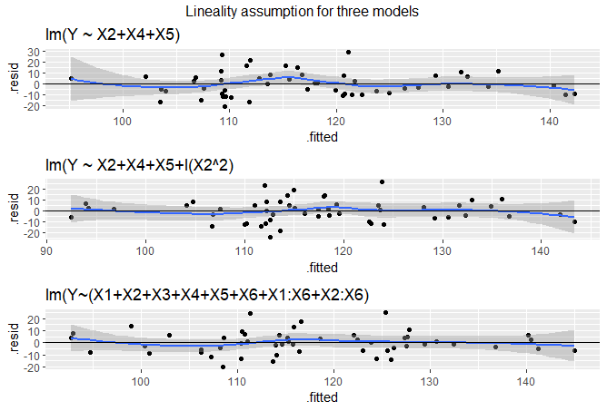
In class Practice Problem 16 Answers
Optimal models from the problem 15:
optimal_model_approach1=lm(Y ~ X2+X4+X5+I(X2^2), data=workhours)
optimal_model_approach2=lm(Y ~ X2+X4+X5+I(X2^2), data=workhours)
optimal_model_approach3 <-lm(Y~(X1+X2+X3+X4+X5+X6+X1:X6+X2:X6), data=workhours)
The bottom two models appear to meet linearity assumption.
Lecture_6.R
17

Slide 18
2. Independence Assumption
An important assumption of the linear regression model is that the error terms, ϵ1, ϵ2, ϵ3, ..., ϵn are uncorrelated (must be mutually independent). What does this mean? For instance, if the errors are uncorrelated, then the fact that ϵi is positive provides little or no information about the sign of ϵi+1.
The assumption of independent errors is violated when successive errors are correlated. This typically occurs when the data for both dependent and independent variables are observed sequentially over a period of time-called time-series data
We can check displays of the regression residuals for evidence of patterns, trends or clumping, any of which would suggest a failure of independence. In the special case when response Y is related to time (time series data), a common violation of the Independence Assumption is for the errors to be correlated. This violation can be checked by plotting the residuals against the order of occurrence (time plot of the residuals and looking for pattern).
In the Advertising example, the subjects were not related to time, so we can pretty sure that their measurements are independent.

Slide 19
Independence Assumption
Lack of independence can be caused by:
Serial correlation (whether this month’s temperature is correlated with the one in the last month’s)
Spatial association
Cluster effect
Make plots of residuals vs relevant explanatory variables and look for pattern
Residuals vs time (or observation number)
Residuals vs spatial variable
Residuals vs group (prefer blocking)
19

Slide 20
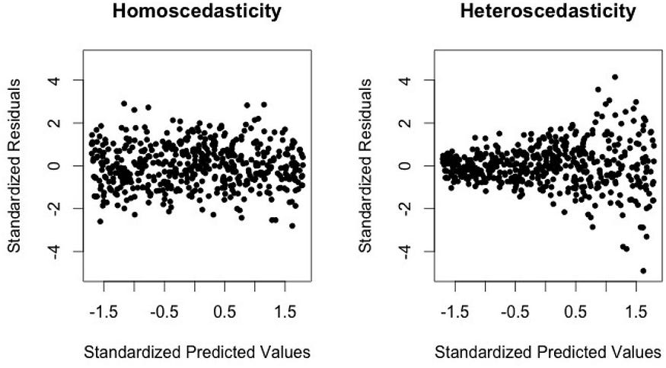
3. Equal Variance Assumption
Another important assumption of the linear regression model is that the error terms have a constant variance (homoscedasticity), Var(ϵi) = σ2. Unfortunately, it is often the case that the variances of the error terms are non-constant. For instance, the variances of the error terms may increase with the value of the response.
One can identify non-constant variances in the errors, or heteroscedasticity
20
Notes:
An example is shown in the left-hand panel of the figure below, in which the magnitude of the residuals tends to increase with the fitted values. When faced with this problem, one possible solution is to transform the response Y using a concave function such as log(Y ) or √X. Such a transformation results in a greater amount of shrinkage of the larger responses, leading to a reduction in heteroscedasticity. The right-hand panel of the figure below displays the residual plot after transforming the response.

Slide 21
Heteroscedasticity
Result of Heteroscedasticity will be an inefficient estimator
Large SE of the estimator
Reasons for heteroscedasticity
The sample size different for each Y
Variance or standard error is a constant percentage of the y-value
How to identify if a model have heteroscedasticity or not?
A scale-location plot between fitted value and standardized residuals can also be checked for heteroscedasticity. It’s also called Spread-Location plot. This plot shows if residuals are spread equally along the ranges of predictors. You can check the assumption of equal variance (homoscedasticity).
21

Slide 22
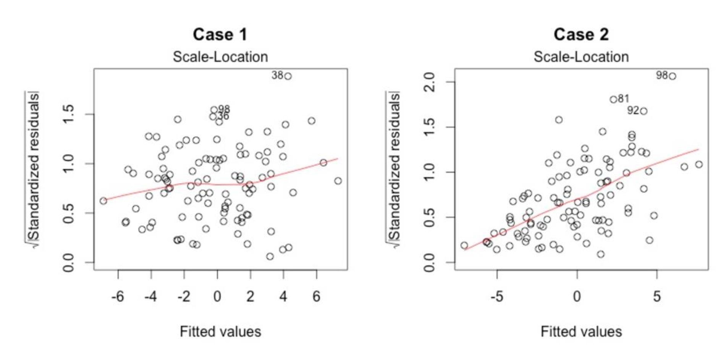
The scale location plot
It’s good if you see a horizontal line with equally (randomly) spread points. From the figure above in Case 1, the residuals appear randomly spread. Whereas, in Case 2, the residuals begin to spread wider along the x-axis as it passes around 5. Because the residuals spread wider and wider, the red smooth line is not horizontal and shows a steep angle in Case 2.
22

Slide 23
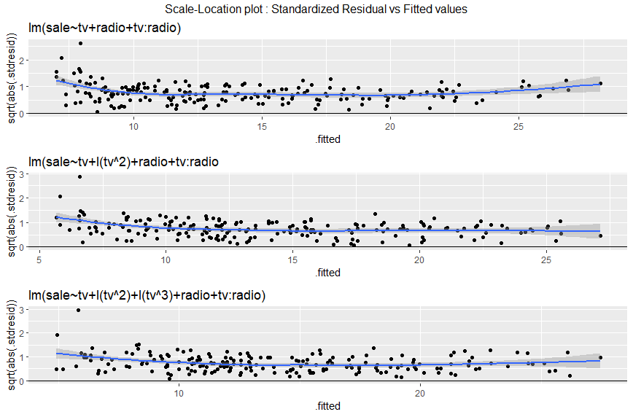
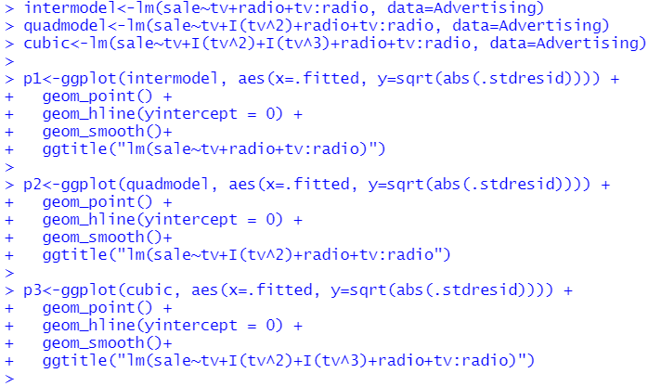
Advertising data Heteroscedasticity
From the Advertising example, the output displays the residual plot and Scale-Location plot that result from the cubic model. In our case, the residuals tend to form a horizontal band-indicates that the plot does not provide evidence to suggest that heteroscedasticity exists.
23

Slide 24
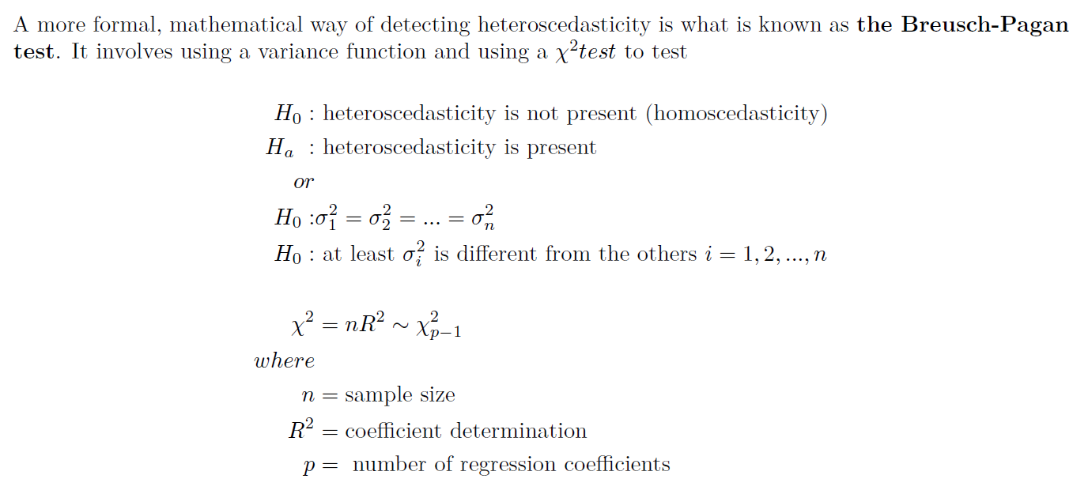
The Breusch-Pagan Test
library(lmtest)
24

Slide 25
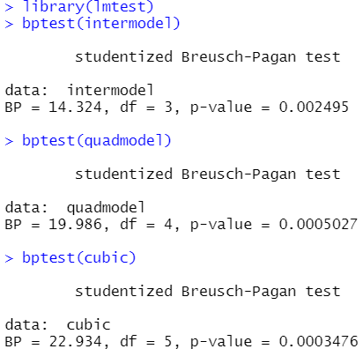
Advertising data
From the Advertising example, the Breusch-Pagan
test p-value are Signiant (p<0.05). We do reject the null hypothesis, which is no presence of Heteroscedasticity.
What can we do now?
25

Slide 26

Coffee break
14:50 pm

Slide 27
How to deal with heteroscedasticity
If you know how the variance changes with each sample
Weighted Least Square Regression
If the variance has unknown dependence on y_{i}
Other regression methods (GMM, generalized method of moments estimation)
If you know the general trend of variance change with the predictor variable, then you can transform the data
Log-transformation
Box-Cox transformations
High order terms

Slide 28
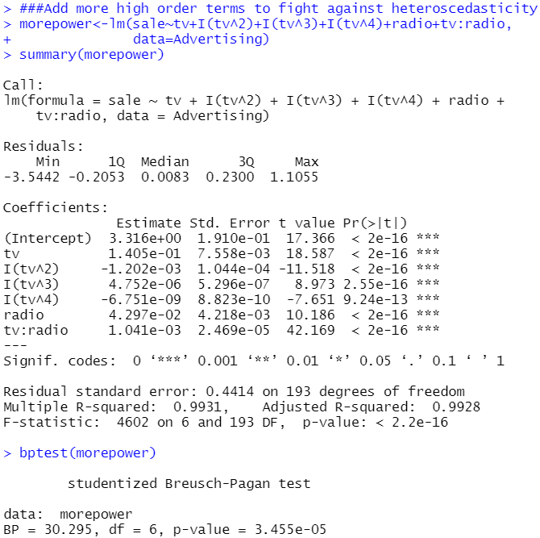
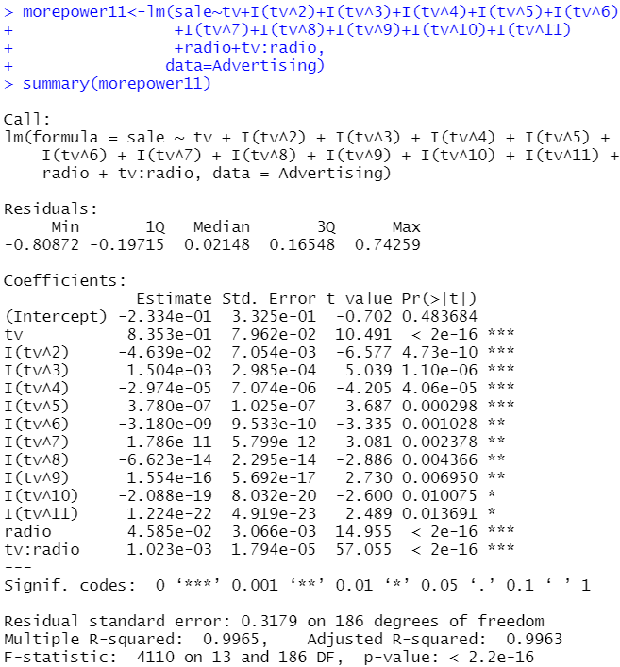
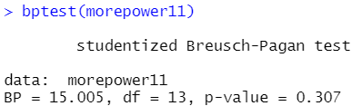
High orders to eliminate Heteroscedasticity

Slide 29
In class Practice Problem 17
Use the CLERICAL.CSV data.
BEGIN with the best model from PROBLEM 16
Y ~ X2 + I(X2^2) + X4 + X5
Does this model meet the equal-variance assumption?
Examine residual plot and scale-location plot
Conduct the Breusch-Pagan test.
Lecture_6.R
29

Slide 30
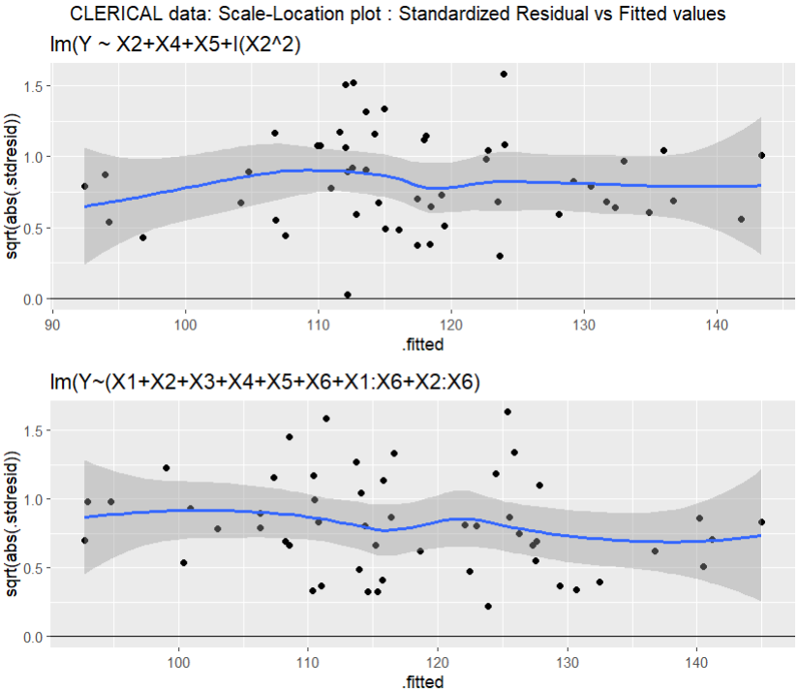
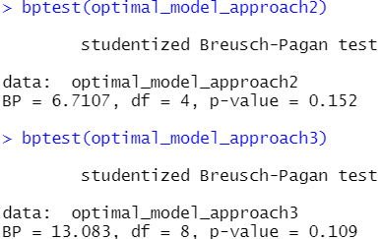
In class Practice Problem 17 Answers
P value 0.152 and 0.109, > 0.05, cannot reject H0.
So we accept H0, which means the error term of model 2 and 3 does not have heteroscedasticity
Lecture_6.R
30

Slide 31
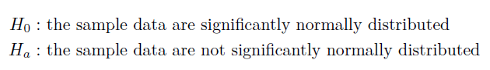
4. Normality Assumption (error)
The multiple linear regression analysis requires that the errors between observed and predicted values (i.e., the residuals of the regression) should be normally distributed.
This assumption may be checked by looking at a histogram, a normal probability plot or a Q-Q-Plot. If the distribution is normal, the points on such a plot (Probability Plot or Q-Q-Plot) should fall close to the diagonal reference line. A bow-shaped pattern of deviations from the diagonal indicates that the residuals have excessive skewness. An S-shaped pattern of deviations indicates that the residuals have excessive kurtosis, i.e., there are either too many or too few large errors in both directions. Sometimes the problem is revealed to be that there are a few data points on one or both ends that deviate significantly from the reference line (“outliers”), in which case they should get close attention.
There are also a variety of statistical tests for normality, including the Kolmogorov-Smirnov test and the Shapiro-Wilk test.

Slide 32
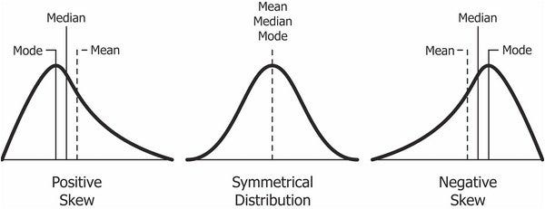
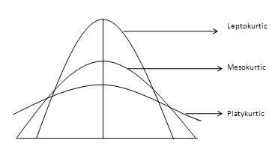
Skewness & Kurtosis
Skewness is a measure of symmetry, or more precisely, the lack of symmetry
Kurtosis is a measure of whether the data are heavy-tailed or light-tailed relative to a normal distribution.
Data sets with medium kurtosis (Mesokurtic, k=3) has kurtosis statistic similar to that of the normal distribution.
Data sets with high kurtosis (Leptokurtic, k<3) tend to have heavy tails, or outliers.
Data sets with low kurtosis ((Platykurtic, k>3) ) tend to have light tails, or lack of outliers.
The histogram is an effective graphical technique for showing both the skewness and kurtosis of data set.
Notes:
Mode: The most frequent number
Positive Skewness means when the tail on the right side of the distribution is longer or fatter. The mean and median will be greater than the mode.
Negative Skewness is when the tail of the left side of the distribution is longer or fatter than the tail on the right side. The mean and median will be less than the mode.

Slide 33
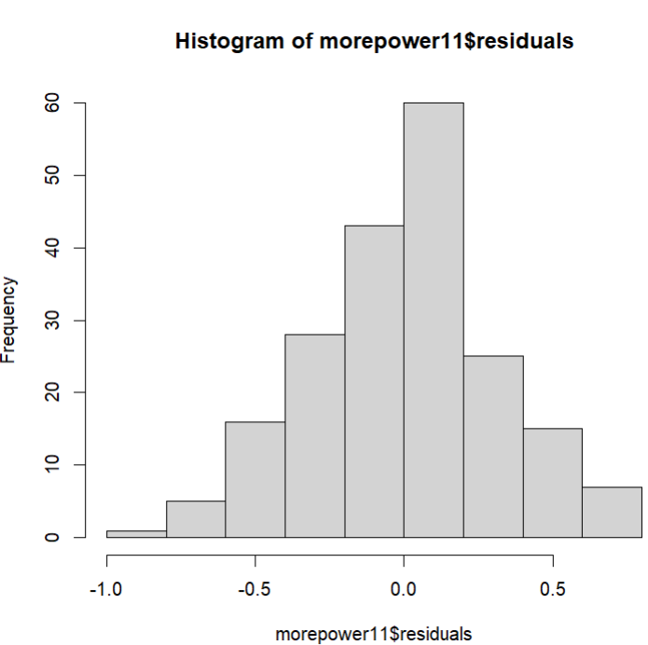
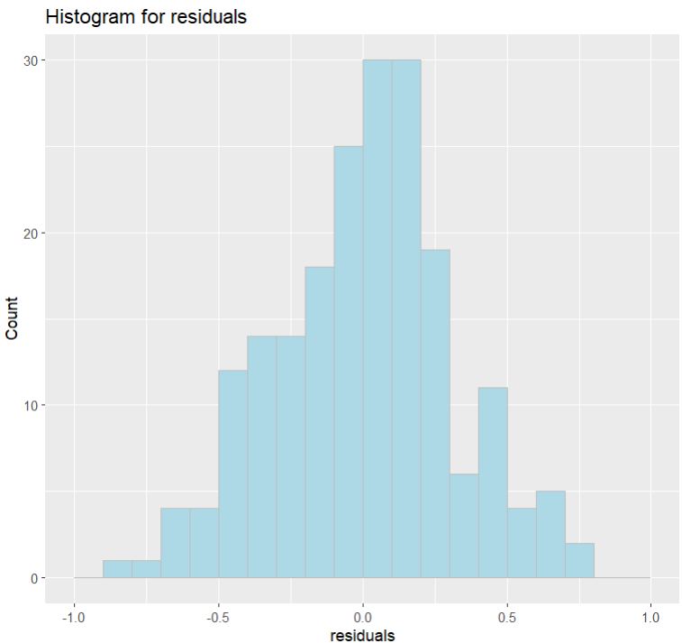
Advertising data Histogram
ggplot(data=Advertising, aes(residuals(morepower11))) +
geom_histogram(breaks = seq(-1,1,by=0.1), col="grey", fill="lightblue") + labs(title="Histogram for residuals") +labs(x="residuals", y="Count")
hist(morepower11$residuals)
33
Notes:
Histogram show the shape of data. I tends to show how the number tend to distribute them throughout dataset. How many data present in the a certain region.

Slide 34
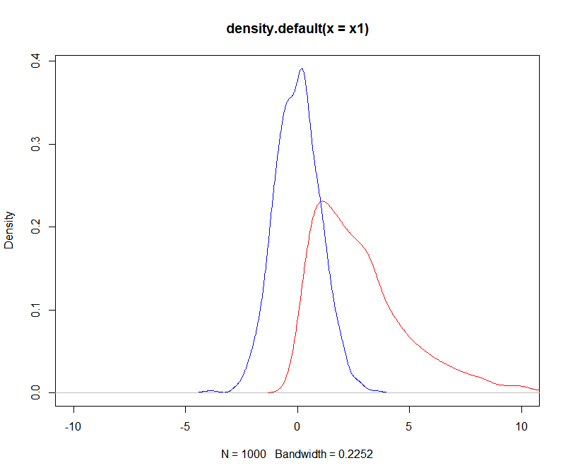
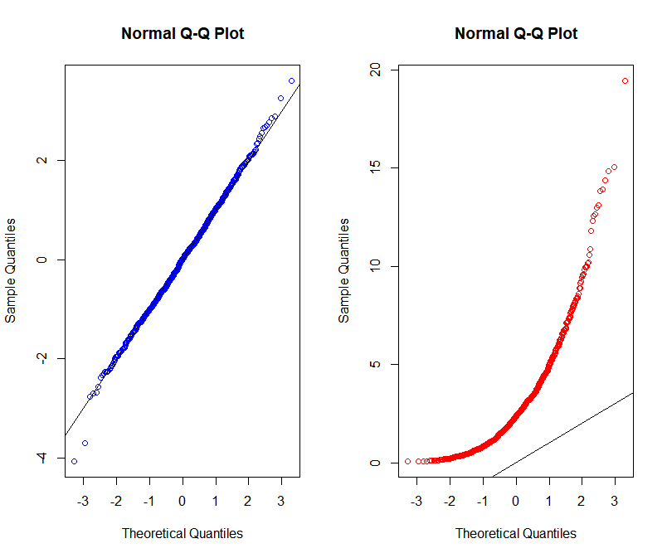
QQ Plot
0%
25%
50%
75%
100%

Slide 35
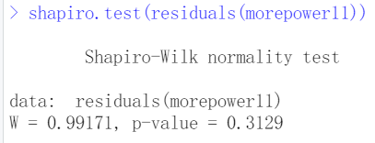
Shapiro Wilk Test

Slide 36
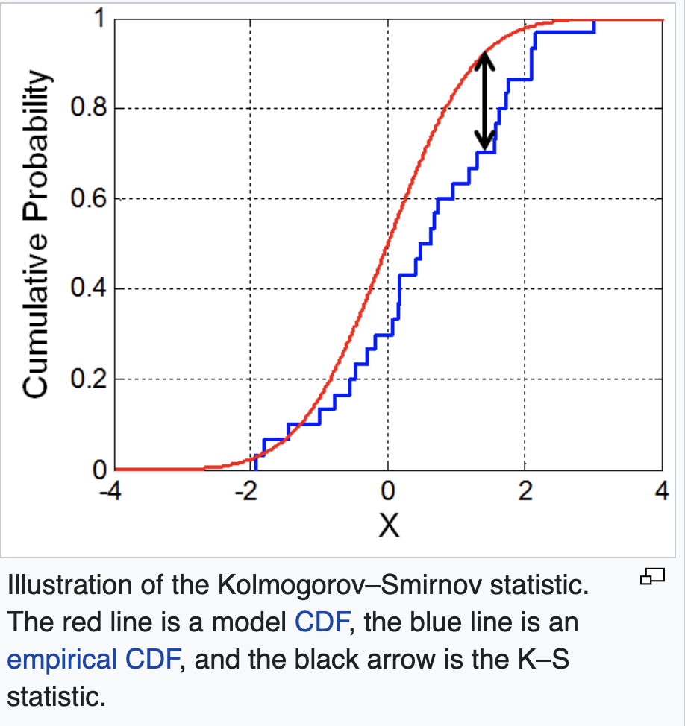
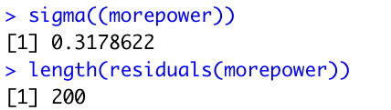
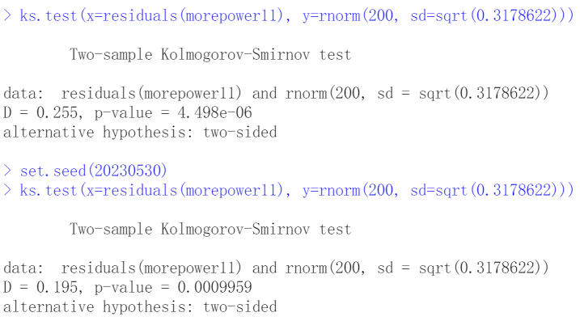
Kolmogorov-Smirnov test

Slide 37
Differences between the two tests
S-W test is a modification of the Kolmogorov-Smirnov (K-S test) and gives more weight to the tails of the distribution than does the K-S test.
The K-S test is distribution free in the sense that the critical values do not depend on the specific distribution being tested.

Slide 38
In class Practice Problem 18
From the clerical staff work hours, use residual plots to conduct a residual analysis of the data. Check Normality Assumption by graphs, Shapiro-Wilk normality test and Kolmogorov-Smirnov test. If you detect a trend, how would you like to transform the predictors in the model?
Lecture_6.R
38

Slide 39
Take away messages
 | Assumptions | Descriptions | Measurements | Potential actions
1 | Linearity Assumption | Relationships between all predictors and the response are linear | 1. residuals – fitted y values plot | Add high order terms or transform data
2 | Independence Assumption | Independence of observations | 1. Residuals vs predictors | Use other models than MLR
3 | Equal Variance Assumption | Error term has equal variance given any values of independent variables | Scale-Location plot. [square root of standardized residuals – fitted y values plot] Breusch-Pagan test (H0: no hetero) | Add high order terms or transform data
4 | Normality Assumption | Error term is normally distributed | Histogram Q-Q plot Kolmogorov-Smirnov test Shapiro-Wilk test | Add high order terms or transform data
5 | Multicollinearity
6 | Outlier

Slide 40

Thank you
Questions OR Comments?
Slack channel: section2-course-documents
Email: qing.li2@uclagary.ca

